Slide 1
Gestational Diabetes
Cristian Ordoñez
DSMES Case Study Presentation
Preceptors: Mary Julius, RDN, LDN, CDE
Neal Kurmas, MS, RD, LD, CDE

Slide 2

Nutrition Assessment
Anthropometrics:
Age: 38
Height: 5’5
Weight: 270 lb
BMI: 43.7
Target BW adj for Obesity: 161 lb
Gestational Diabetes Hx:
Pregnancy #1 2005 miscarriage at 9 weeks
Pregnancy #2 2016 GDM with return to normal following delivery
Pregnancy #3 2017 GDM, dx with T2DM after delivery
Pregnancy #4 2020 currently 7 weeks gestation
Wt hx: Consistent 270-275 past ~1 year
Notes:
Veteran was previously on insulin during her last pregnancy #3 but then did not use it afterwards.

Slide 3

Nutrition Assessment (cont.)
Labs:
HA1c of 6.2 indicating well-controlled DM.
Dyslipidemia likely r/t dietary indiscretions.
Low Vit D
Diet Recall:
Notes:
Weight: Current wt 270# and BMI 45 indicating Veteran is morbidly obese.
Veteran has maintained consistent wt between 170-175 in past 1 year with no
significant fluctuations. Current goal is wt gain 11-20# throughout the course
of pregnancy.
Diet recall: Most of the kcal came from her snacks she ate throughout the day and from her lunch which she generally ate out at restaurants due to time constraints

Slide 4
Distinction between GDM & T2DM Dx
GDM was previously defined as “any degree of glucose intolerance with onset of or first recognition during pregnancy ” - ADA 1997
Currently defined as GDM as “diabetes diagnosed in the second or third trimester of pregnancy that was not clearly overt diabetes prior to gestation” – ADA 2019
Recommendations:
Test for pre-existing diabetes in those with risk factors at first prenatal visit
Test for GDM 24-48 weeks gestation in women with no prior hx of DM
Test women with GDM for persistent DM at 4-12 weeks post-partum
Notes:
Unlike women with Type 1 diabetes, women with GDM have a lot of insulin, sometimes more than the average person. But insulin resistance increases due to a blocking effect of certain hormones produced by the placenta.
Some hormones that have this blocking effect are estrogen, cortisol, and human placental lactogen (HPL). As the size of the placenta grows, the number of these hormones produced increases along with the insulin resistance, therefore GDM is usually diagnosed about halfway through the pregnancy.
In most women the pancreas is able to produce more insulin to make up for the increased insulin resistance, but when the pancreas produces as much insulin as it can but it is still not enough to keep up with the insulin resistance of the placental hormones, then GDM occurs.
Risk factors are the same risk factors as those for type 2 diabetes
Diabetes that exists before this gestational period of 24-48 weeks (which is when amount of hormones released by pancreas that cause insulin resistance is high enough to lead to insulin resistance) is known as preexisting diabetes.

Slide 5
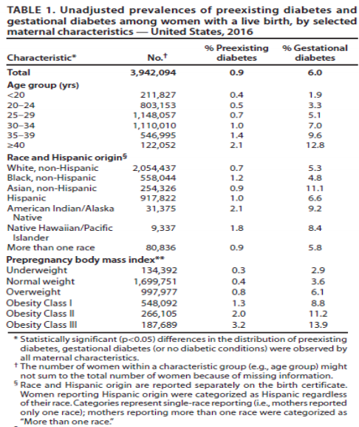
6% prevalence of GDM
GDM rates by race
Notes:
Prevalence of diabetes in the US is increasing along with the increase in obesity rates.

Slide 6
Evidence-Based Nutrition Practice Guidelines for GDM
MNT goals are to provide adequate nutrients for appropriate weight gain
Self management is essential aspect of MNT
Blood glucose monitoring
Diet
PA
Self-monitoring of diet and BG to make meal plan adjustments
Notes:
file:///Users/cristianordonez/Downloads/GDM_AND_Gestational%20Diabetes%20Evidence-based%20Nutrition%20Practice%20Guideline%202018%20(1).pdf

Slide 7
Nutrition Diagnosis
Excessive energy intake
Related to: dietary indiscretions, increased appetite 2/2 pregnancy
As evidenced by: diet recall, BMI of 45

Slide 8
Nutrition Intervention
Educated on carbohydrate counting and important of SMBG
Offered alternative cooking methods & snack dietary options
Coordinate with endocrine to provide CGM
Vit D supplementation

Slide 9
Monitoring & Evaluation
1. Weight
Goal: Wt gain 11-20# throughout course of pregnancy.
2. Labs
Goal: before meal glucose double digit, post prandial less than 140, anticipate need for NPH insulin. Veteran aware that NPH insulin may be required.
3. Veteran is willing to allow me to call her regularly to work on nutrition and is also willing to share glucose data using technologies.
Notes:
Was not previously on insulin, but prior history with GDM shows she will most likely need to be provided with insulin as pregnancy progresses and insulin resistance increases.

Slide 10
References
Duarte-Gardea MO et al. J Acad Nutr Diet 2018;118:1719-1742.
Management of diabetes in pregnancy: Standards of medical care in diabetes--2019. Diabetes Care 2019;42(suppl 1):S165–S172; CDC. National Diabetes Statistics Report, 2017. https://www.cdc.gov/diabetes/data/statistics-report/index.html
Maria O. Duarte-Gardea, Diana M. Gonzales-Pacheco. Academy of Nutrition and Dietetics Gestational Diabetes Evidence-Based Nutrition Pratice Guideline. Journal of The Academy of Nutrition and Dietetics.
Nielsen GL, Møller M, Sørensen HT. HbA1c in early diabetic pregnancy and pregnancy outcomes: a Danish population-based cohort study of 573 pregnancies in women with type 1 diabetes. Diabetes Care 2006;29:2612–2616
Notes:
American Cancer Society (ACS), US Multi-Society Task Force on Colorectal Cancer, and American College of Radiology

